Slide 1

Unlocking Tomorrow's Minds: The Power of Smart Education
Embark on a journey to transform learning through innovation and intelligence.

Slide 2
Agenda: Charting Our Course for Educational Excellence
1
Defining Smart Education
Understanding the core principles and what sets it apart.
2
Key Pillars of Smart Learning
Exploring the foundational elements that drive success.
3
Technology Integration: Tools for Transformation
Showcasing the digital innovations empowering educators and learners.
4
Benefits for Every Stakeholder
How smart education impacts students, teachers, and administrators.
5
Challenges & Solutions
Addressing potential hurdles and outlining strategic approaches.
6
Real-World Impact: Case Studies
Illustrating success stories from institutions embracing smart education.
7
The Future of Learning
Gazing into the crystal ball for what's next in education.

Slide 3

What is Smart Education? More Than Just Digital Tools
Smart Education is a holistic approach that integrates advanced technologies like AI, IoT, and adaptive learning platforms to create personalised, engaging, and effective learning experiences.
It's about leveraging data, connectivity, and intelligent systems to foster critical thinking, creativity, and problem-solving skills, preparing students for an ever-evolving world.
It's a paradigm shift from traditional teaching, moving towards dynamic and responsive educational environments.

Slide 4





The Five Pillars of Smart Learning: Building a Resilient Framework
Personalisation
Engagement
Data-Driven Insights
Tailoring content and pace to individual student needs.
Utilising interactive tools and gamification to capture interest.
Using analytics to inform teaching strategies and student support.
Connectivity
Future-Ready Skills
Seamless access to resources and collaborative platforms.
Fostering 21st-century competencies like critical thinking and digital literacy.
These pillars collectively create an adaptive and enriching educational ecosystem.

Slide 5
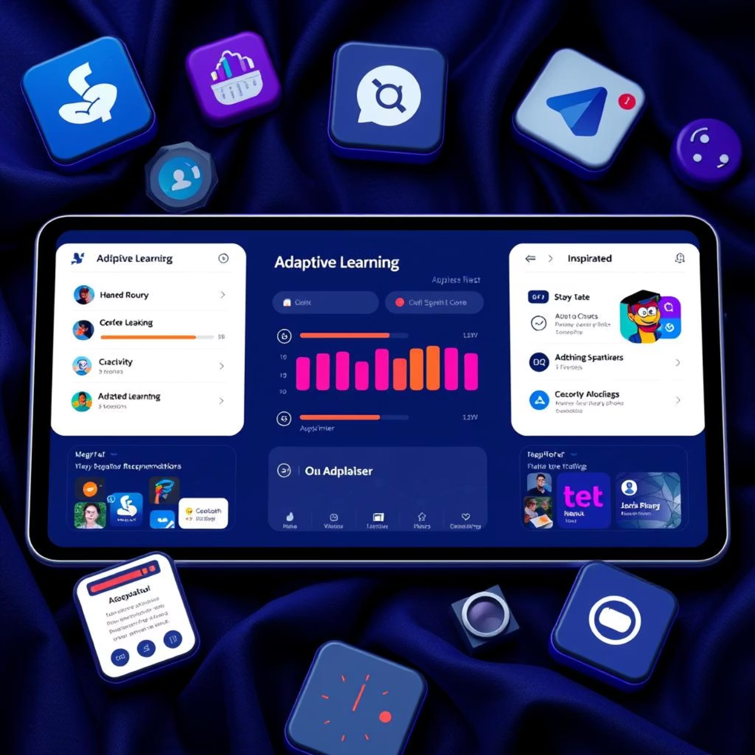
Technology Integration: Empowering Education with Intelligent Tools
From AI-powered tutors to virtual reality field trips, technology is transforming the classroom experience.
Adaptive Learning Platforms: Personalised pathways for every student.
Virtual & Augmented Reality: Immersive experiences that bring subjects to life.
AI-Driven Analytics: Identifying learning patterns and intervention needs.
IoT-Enabled Classrooms: Smart environments for enhanced safety and efficiency.
Collaborative Digital Tools: Fostering teamwork and global connections.
These tools are not just supplements; they are integral to a smart learning environment.

Slide 6



Benefits for All: A Win-Win for the Educational Ecosystem
For Students
For Educators
Increased engagement, personalised learning, and enhanced critical thinking skills.
Data-driven insights, reduced administrative burden, and innovative teaching methods.
For Institutions
For Policy Makers
Improved outcomes, operational efficiency, and a reputation for innovation.
Equitable access, future-ready workforce, and global competitiveness.

Slide 7
Navigating the Hurdles: Challenges and Strategic Solutions
Challenges
Solutions
Digital Divide: Unequal access to technology.
Government Initiatives: Subsidies and public access programs.
Teacher Training: Equipping educators with new skills.
Continuous Professional Development: Ongoing training for educators.
Data Privacy: Ensuring secure handling of student information.
Robust Cybersecurity: Implementing strong data protection protocols.
Infrastructure: Reliable connectivity and device availability.
Phased Implementation: Gradual rollout and infrastructure upgrades.
Proactive planning and collaboration are key to overcoming these challenges.

Slide 8
Real-World Impact: Pioneering Smart Education in India
2020: Delhi Government Schools
1
Implemented smart classrooms with digital whiteboards and e-content, leading to a 15% increase in student engagement.
2
2021: SRM Institute of Science and Technology
Adopted an AI-powered learning management system, resulting in improved student retention rates by 10%.
2022: Byju's Think & Learn App
3
Reached 150 million users by offering adaptive learning paths and engaging video lessons, democratising access to quality education.
4
2023: Kendriya Vidyalayas
Piloted IoT devices for smart campus management, enhancing safety and resource utilisation across multiple schools.
These examples highlight the transformative potential when vision meets implementation.

Slide 9

The Future of Learning: Tomorrow's Classroom, Today
Hyper-Personalised Learning: AI-driven paths adapting in real-time.
Global Collaboration: Students connecting across continents seamlessly.
Emphasis on Soft Skills: Developing creativity, empathy, and critical thinking.
Lifelong Learning Ecosystems: Continuous education integrated into daily life.
The future promises an educational landscape that is dynamic, inclusive, and infinitely adaptable.

Slide 10

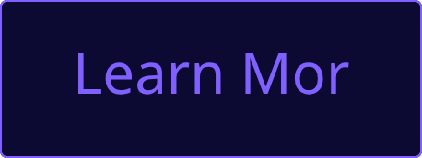
Key Takeaways & Next Steps: Join the Smart Education Movement
Embrace Innovation
Collaborate for Impact
Prioritise People
Smart education is a necessity, not a luxury, for preparing future generations.
Technology serves to enhance human potential, not replace it.
Partnerships between educators, technologists, and policymakers are crucial.
Ready to transform your educational approach? Let's connect and build smarter learning environments together.

